Slide 1
Parenting Seminar (part 2)
(Sunday 18th June, 7.30-9pm)
Family Worship
Enabling scripture, song, prayers & discussion in the home
  *In the chat pane please type in*
When you consider the topic of ‘family worship’ how does that make you feel?
What (if anything) did your parents do with you, or have you done with your children?
What questions do you have coming into this seminar?
Notes:
When you consider the topic of ‘family worship’ how does that make you feel?
What (if anything) did your parents do with you, or have you done with your children?
What questions do you have coming into this seminar?
--
Leanne and I are hosting 3 parents seminars on zoom on 3 different Sunday nights, 7.30-9pm, starting this Sunday. If you're interested, do come along to any or all of them - they do link together, but can standalone.
Sunday 28th May - Biblical wisdom for raising children
Sunday 18th June - Family Worship
Sunday 9th July - The Tech-wise Family
More details (and zoom details) can be found here - www.christcitychurch.ie/parenting-seminar
Resources will continue to be added to this page before/after each seminar
P.S Zoom Details (7.30-9pm)
Meeting Link – https://us06web.zoom.us/j/84262925050?pwd=ekoxQTM5ZG5GMUVDeUNlWnVBQ0wydz0
Meeting ID – 842 6292 5050
Passcode – 928772

Slide 2
5 biblical principles for parentings
Aim for your child’s heart
Examine your own heart
More is caught than taught
Time takes time
Establish boundaries & consistent consequences
Notes:
Part 1 summary

Slide 3
Some opening thoughts
4 Pastoral Comments
Parenting is hard and we often feel inadequate (esp. when it comes to family worship
CCC – creating a supportive community
Dangers of legalism (in this area)
A wonderful and joyful opportunity

Slide 4
Part 1 - WHY Family Worship
The biblical basis
Deuteronomy 5:16=
“Honor your father and your mother, as the Lord your God has commanded you, so that you may live long and that it may go well with you in the land the Lord your God is giving you.

Slide 5
Part 1 - WHY Family Worship
The biblical basis
Deuteronomy 6:4-9 (& 11:19)
⁴ Hear, O Israel: The LORD our God, the LORD is one. ⁵ Love the LORD your God with all your heart and with all your soul and with all your strength. ⁶ These commandments (the 10 commandments) that I give you today are to be upon your hearts. ⁷ Impress them on your children. Talk about them when you sit at home and when you walk along the road, when you lie down and when you get up

Slide 6
Part 1 - WHY Family Worship
The biblical basis
Proverbs 1:8-9
⁸ Listen, my son, to your father’s instruction
and do not forsake your mother’s teaching.
⁹ They are a garland to grace your head
and a chain to adorn your neck.
¹⁰ My son, if sinful men entice you,
do not give in to them.

Slide 7
Part 1 - WHY Family Worship
The biblical basis
Proverbs 22:6
Start children off on the way they should go, and even when they are old they will not turn from it.

Slide 8
Part 1 - WHY Family Worship
The biblical basis
Ephesians 6:4
Parents do not exasperate your children; instead, bring them up in the training and instruction of the Lord.

Slide 9
Part 1 - WHY Family Worship
Other reasons
Someone is going to catechise your kids
“You have it said…but I say to you…”(Matthew 5:21-48)

Slide 10
Modern Secular Catechism (Tim Keller)
Identity: “You have to be true to yourself.”
Freedom: “You should be free to live as you choose, as long as you don’t hurt anyone.”
Happiness: “You must do what makes you happiest. You can’t sacrifice that for anyone.”
Science: “The only way to solve our problems is through objective science and facts.”
Morality: “Everyone has the right to decide what is right and wrong themselves.”
Justice: “We are obligated to work for the freedom, rights, and good of everyone in the world.”
History: “History is bending toward social progress and away from religion.”

Slide 11
Modern Culture = Expressive Individualism
  You be you.
  Be true to yourself.
  Follow your heart.
  Find yourself.
  You define what’s right and wrong for you

Slide 12
Modern Secular Catechism (Mark Sayers)
The highest good is individual freedom, happiness, self-definition, and self-expression.
Traditions, religions, received wisdom, regulations, and social ties that restrict individual freedom, happiness, self-definition, and self-expression must be reshaped, deconstructed, or destroyed.
The world will inevitably improve as the scope of individual freedom grows. Technology —in particular the internet—will motor this progression toward utopia.
The primary social ethic is tolerance of everyone’s self-defined quest for individual freedom and self-expression. Any deviation from this ethic of tolerance is dangerous and must not be tolerated. Therefore social justice is less about economic or class inequality, and more about issues of equality relating to individual identity, self-expression, and personal autonomy.
Humans are inherently good.
Large-scale structures and institutions are suspicious at best and evil at worst.
Forms of external authority are rejected and personal authenticity is lauded.

Slide 13
The bible’s catechism
“my truth” - All truth is God’s truth; He is the truth
“do what makes you happy” - you don’t belong to yourself; you’re a creature made by God and accountable to God
“follow your heart” - the heart is deceitful; it’s not a compass
“you can’t help who you love” - were not free to act on every impulse; our bodies belong to God
“what I feel like on the inside is more accurate than my body” - your body has a purpose and design given by God

Slide 14
Part 1 - WHY Family Worship
Other reasons
Someone is going to catechise your kids
It centres the home & binds the family together
It encourages peace & Christian character in the home
It models & trains children in private worship & life-long discipleship

Slide 15
Spiritual Practices Common To Kids Who Flourish As Adults
Bible
Prayer
Service (church is not about mere attendance & consuming)
Singing Christian songs
Culture not programs
The power of imitation & environment
Notes:
https://www.thegospelcoalition.org/blogs/trevin-wax/parents-take-note-spiritual-practices-common-kids-flourish-adults/?amp

Slide 16
Part 2 - HOW to do Family Worship
The bible
Discussion
Prayer
Song

Slide 17
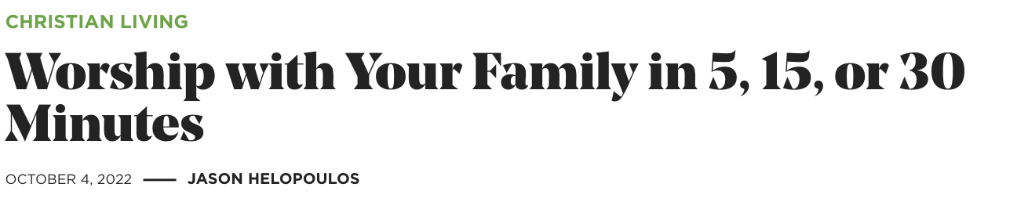
Part 2 - HOW to do Family Worship
Notes:
https://www.thegospelcoalition.org/article/worship-family-minutes/

Slide 18
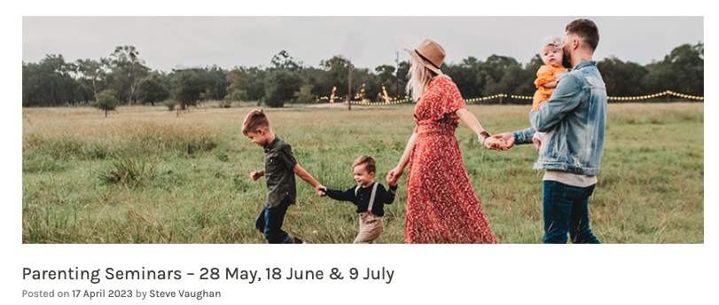
Part 2 - HOW to do Family Worship
Notes:
https://www.christcitychurch.ie/parenting-seminar/

Slide 19
Part 2 - HOW to do Family Worship
Some comments
Keep it simple, enjoyable & attainable
Respond to their questions
Initiative & lead the tough conversations
Find your (a) time, (b) place & (c) rhythmn

Slide 20
Part 2 - HOW to do Family Worship
Our efforts…
0-5 years old
Songs at bedtime
Songs at mealtimes + 2 prayers
Holding hands to pray and sing
Bible-story & prayers at bedtime
Discussions at mealtimes, and adhoc

Slide 21
Part 2 - HOW to do Family Worship
Our efforts…
0-5 years old
5-10 years old
Song at meal time and 2 prayers
Bible story & discussion at bedtime
Bedtime prayers

Slide 22
Part 2 - HOW to do Family Worship
Our efforts…
0-5 years old
5-10 years old
10+
Family bible study after dinner - Gospels + Acts (Romans broke us) - 5 questions & then praying
Following a Bible study guide for teenagers
Choosing a song each and singing and then praying
Encouraging them in private devotions
Joined the local youth club

Slide 23
Part 2 - HOW to do Family Worship
Jez & Sharon’s experience & ‘a worked example’

Slide 24
Part 2 - HOW to do Family Worship
Our hope is in God not ourselves

Slide 25
Discussion (breakout rooms till 8.35pm)
**take a photo this slide**
What most stood out for you?
What do you want to reflect on more?
What to do you want to start doing?
What questions are you left with?
WHY family worship (biblical & other reasons)
HOW to do family worship (bible, discussion, prayer & song)

Slide 26
Open Q&A (till 9-9.30pm)
Shared Wisdom
Unmute yourself or put your questions in the chat

